Slide 1

IT Incident Management Analysis (An End-to-End Data Warehouse Project)
By: Sumit Chhetri
Submitted to: Prof. Maryam Erfanian Sabee

Slide 2
Table of contents
01. Introduction
About IT incident Management
Problems and Goal
02. Dataset
About dataset
Data cleaning, Exploration and Analysis
03. Business and data warehouse
Identifying Business Grains
Data Warehouse Designing
04. Extract, Transform and Load
Jobs and Transformation
05. Getting Insights
06. Future Enhancement and Conclusion

Slide 3


01
Introduction

Slide 4

About IT Incident Management
Unplanned interruption or reduction in quality of IT services.
Can range from minor to major incidents.
Incident management is needed to:
Reduce Downtime
User Satisfaction
Process Improvement
Fulfil Service-Level-Agreement (SLA)
Three key components:
Knowledge Management
Problem Management
Incident Handling Process

Slide 5




A Typical Incident Management Process
Customer Reporting Incident
Registering Incident Information
Incident Handling
Closing the Incident
Caller Id
Reported medium
Incident Occurred date
Incident registered date
Registered by
Responsible person
Incident State
Incident Number
Updating/resolving Information
Task group
Problem cause
Close date
Closed by
Closed code
01
02
03
04

Slide 6




Business Problems:
Identifying Top Incidents for reducing down-time
Use of Knowledge Management
Tracking SLA and Ticket Resolution
Employees response to handle incidents

Slide 7

The Goal
“Build a complete end-to-end ETL-based data warehouse solution to gain insights for reported incidents within an organization.”

Slide 8

02
Dataset

Slide 9

Dataset
Source : Kaggle.com (Incident Log data)
Type: Semi-structure CSV file
Columns: 36 (21 String, 4 Boolean, 8 Date Time and 3 Integer)
Rows: 141726

Slide 10

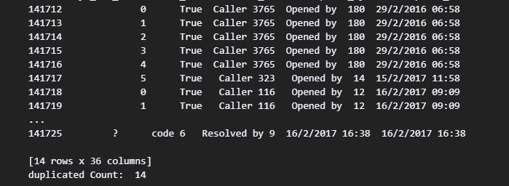
Data Exploration and Cleaning
1. Total Data :
2. Duplicate data identification before loading to table

Slide 11
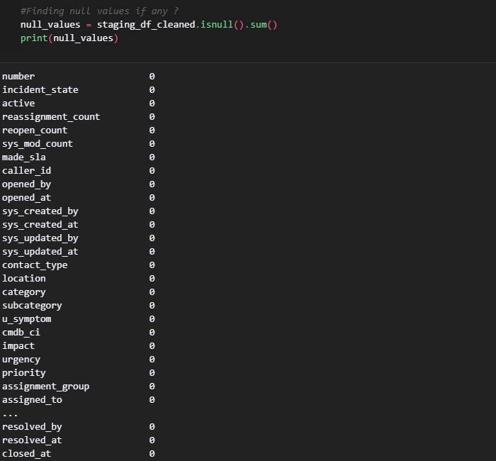

Data Exploration and Cleaning (contd..)
3. Duplicate record dropped which left us with (141712 X 36) unique row.
4. No null values found.
Wait. So, there’ nothing wrong?

Slide 12
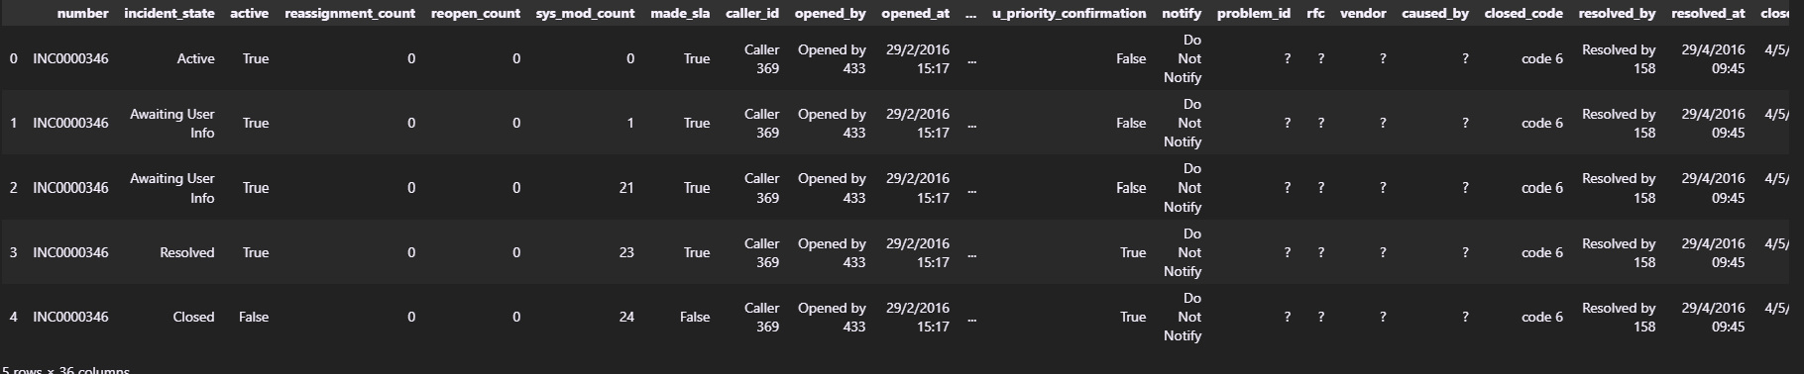
Data Exploration and Cleaning (contd..)
4. Invalid Values

Slide 13
Data Exploration and Cleaning (contd..)
4.

Slide 14
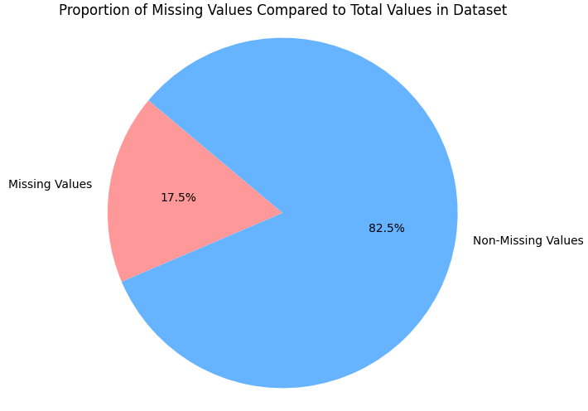
Data Exploration and Cleaning (contd..)
4. Invalid Values
17.5% data are missing that is around 90000 cells have the invalid value ‘?’

Slide 15
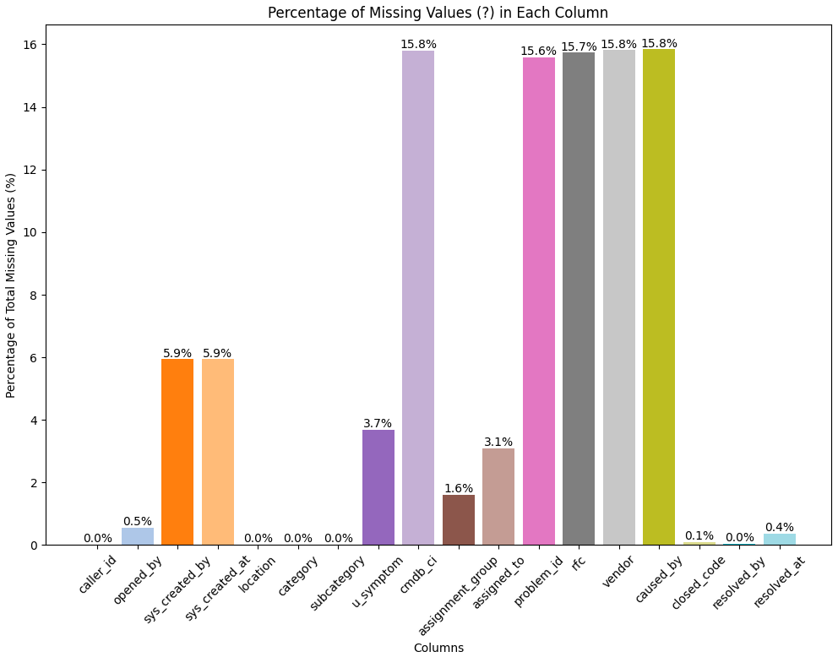
Data Exploration and Cleaning (contd..)
cmdb_ci, problem_id, rfc, caused_by and vendor has the most missing values (78.7%) out of all missing values
sys_created_by, sys_created_at, u_symptom, assigned_to, assignment_group, closed_code, resolved_at have missing values ranging from 0.1% to 6%

Slide 16
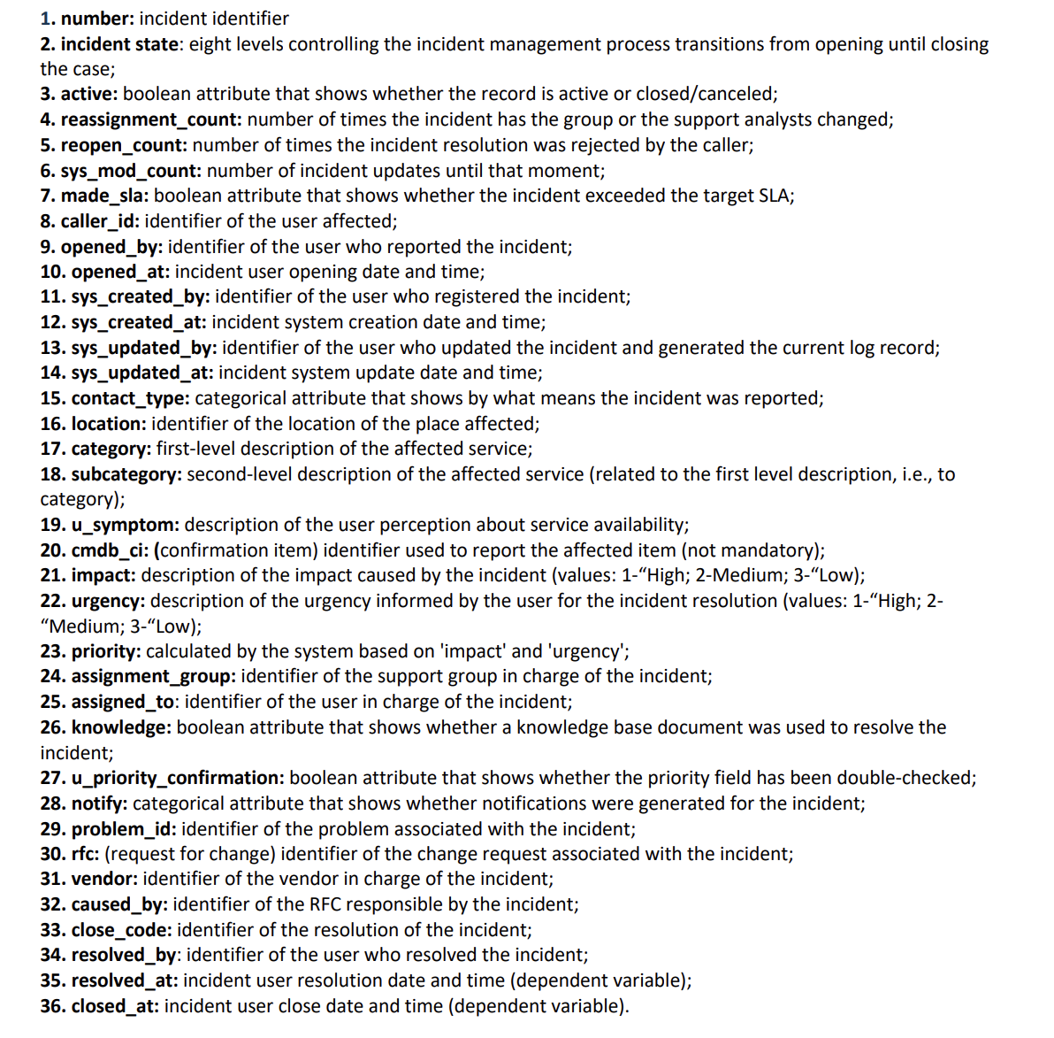


78.7% out of all missing values
Where and why incident occurred?
0.1% to 6% missing values
Employee and dates

Slide 17
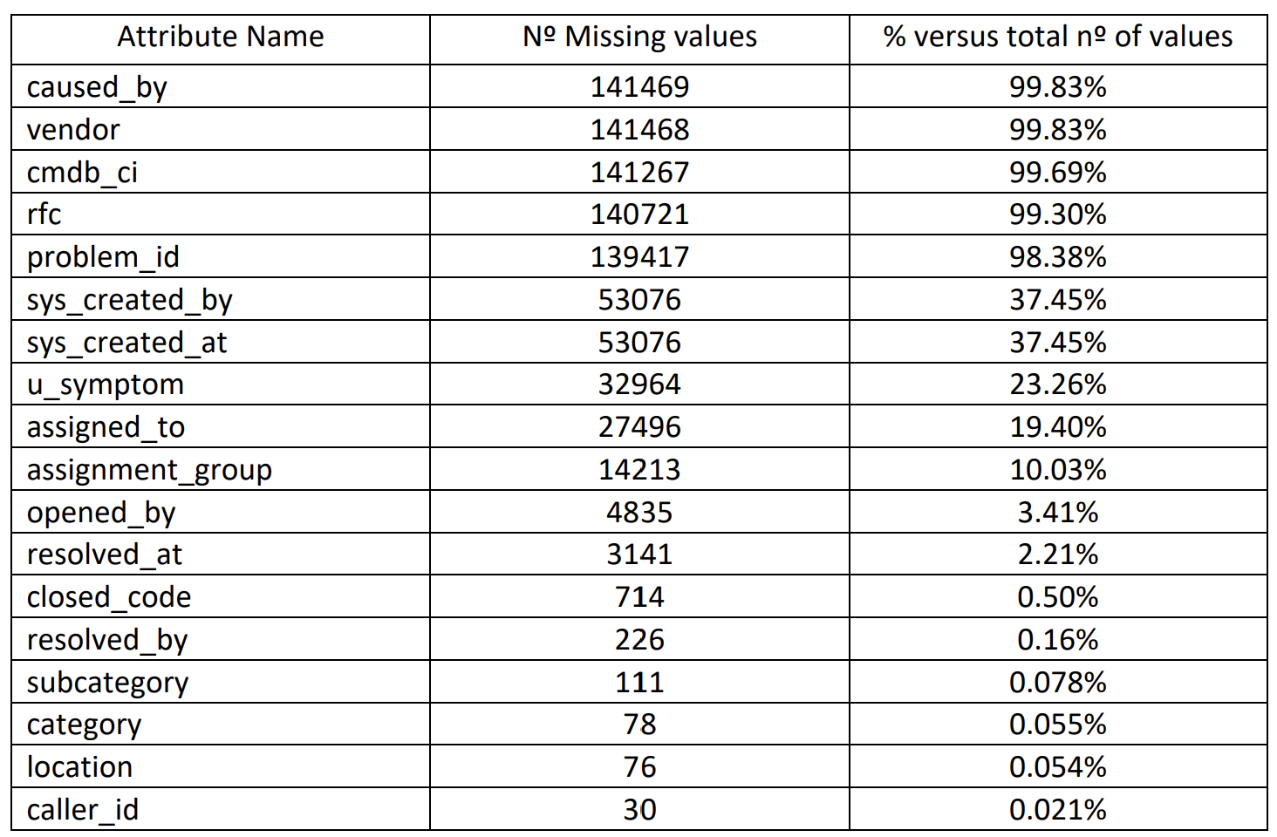
Handling Invalid Values
replace ‘?’ with opened_by
replace ‘?’ with opened_at
replace ‘?’ with default ‘0’
replace ‘?’ with default employee ‘0’
replace ‘?’ with default ‘0’
replace ‘?’ with default ‘employee 0’
replace ‘?’ with close_at
replace ‘?’ with default_code
replace ‘?’ with updated_by
replace ‘?’ with respective default values ‘0’

Slide 18
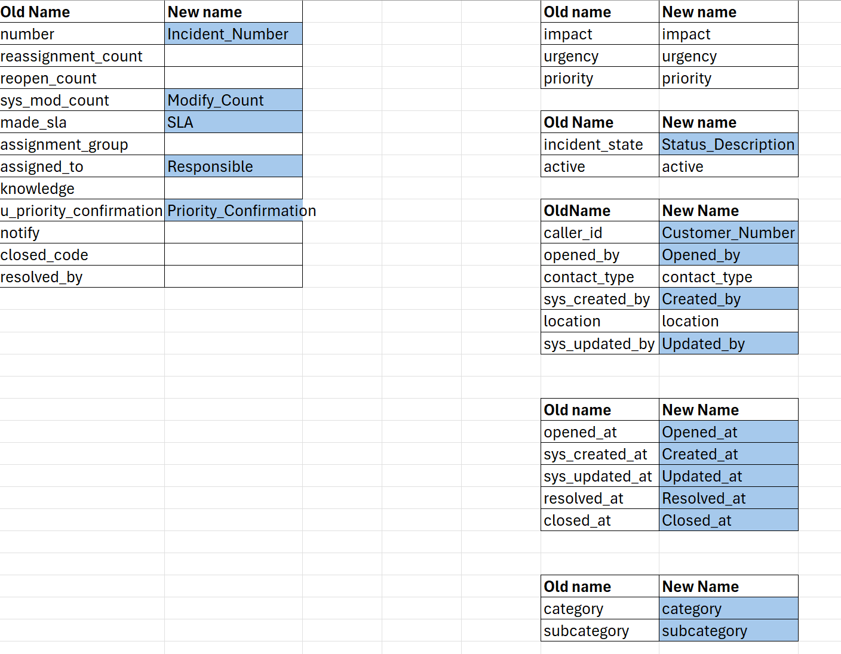
Redefining Field Names

Slide 19

03
Business Grains Data Warehouse Design

Slide 20
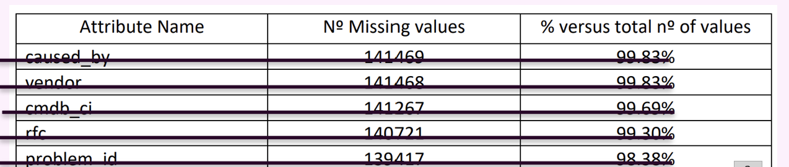
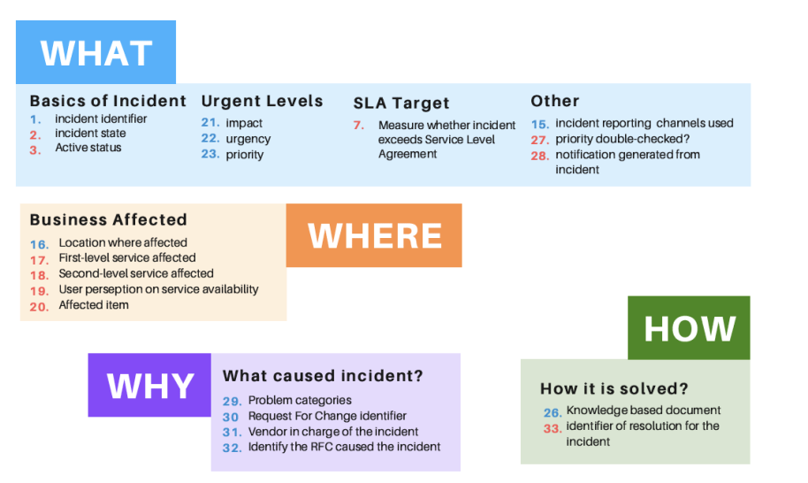
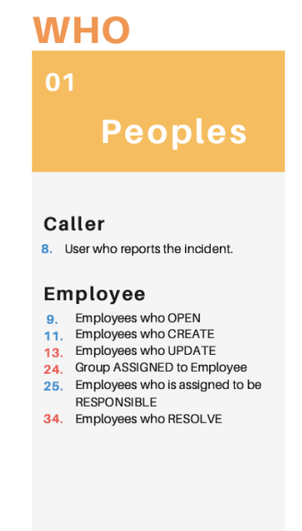
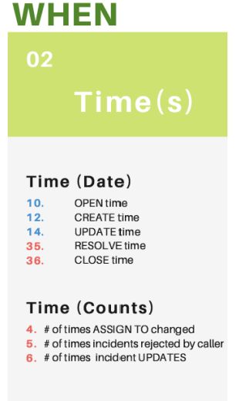
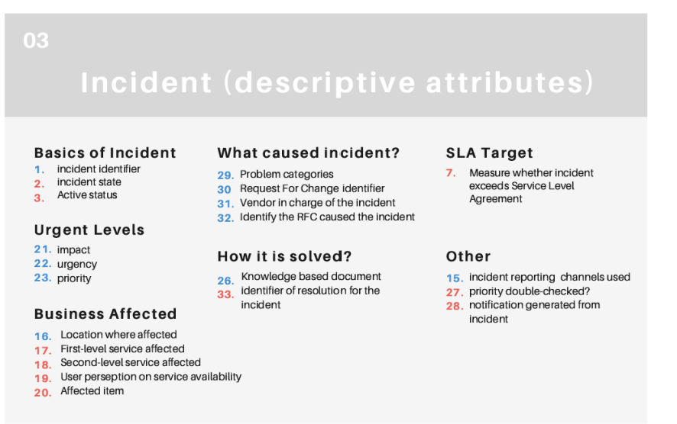
Business Grains
Around 98% percent of information were missing regarding Where and Why aspect.

Slide 21
Database Warehouse Schema

Slide 22
FKs references idDate

Slide 23
FKs references employee_num

Slide 25
Data Warehouse Schema
date_stamp
data_source

Slide 26

04
Extract, Transform and Load

Slide 27
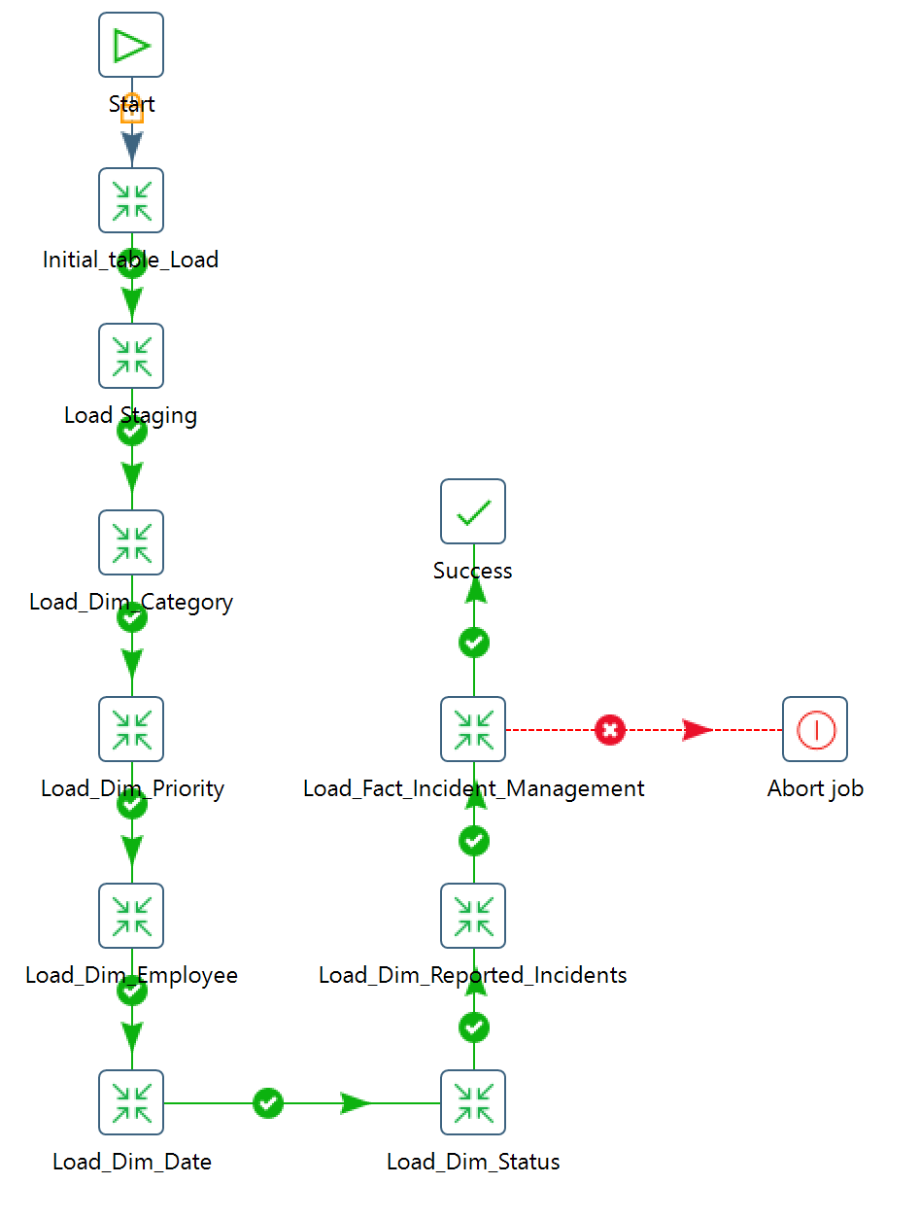
Job And Transformations
9 Transformations

Slide 28
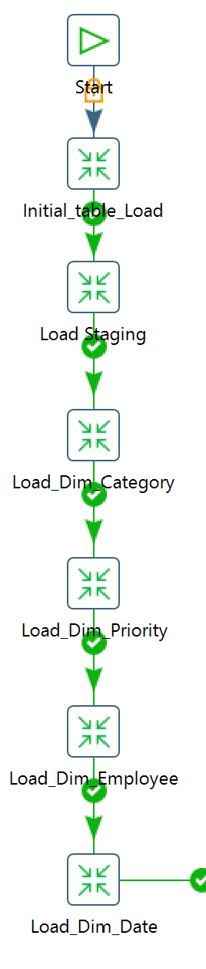
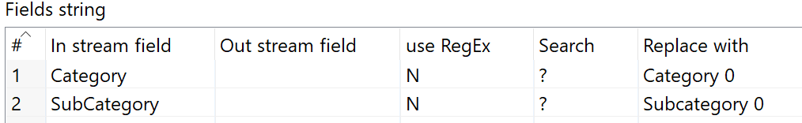
Loading Category Dimension
Notes:
ETL for Category Dimension:
Categories and Subcategories Selection.
Handling missing values by replacing with Generic Category = "Category 0" - "Subcategory_0".
Unique combinations of Category and Subcategory identified.
Got the Metadata of running this transformation.(data_source, date_stamp)
Loaded the rows to the Database - Category Table.

Slide 29
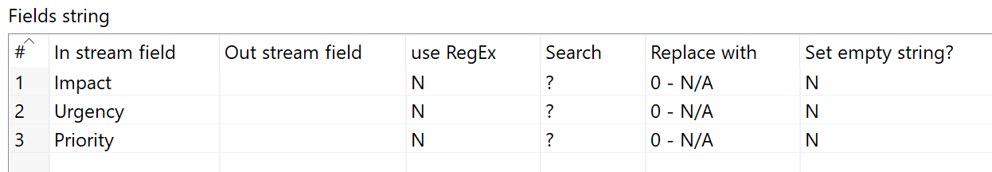
Loading Priority Dimension
Notes:
ETL for Priority Dimension:
Selected the Priority, Impact and Urgency columns.
Replaced the missing values with a Generic Priority = "0".
Identified the possible unique combinations.
Got the Metadata of running this transformation.
Loaded the rows to the Database - Priority Table.

Slide 30
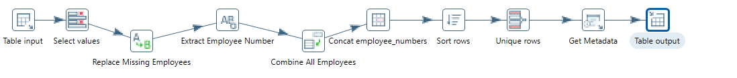
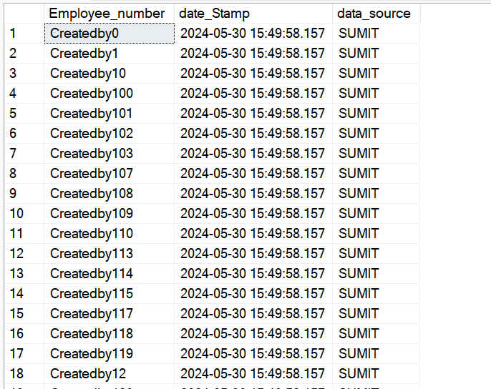
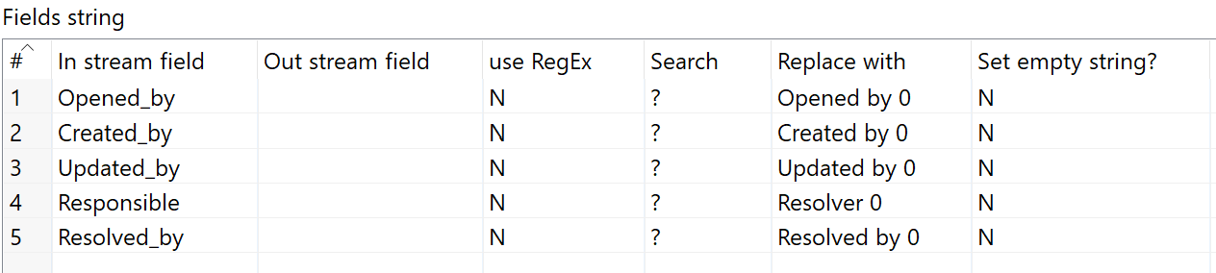
Loading Employee Dimension
Notes:
This process cover the ETL for Employee Dimension:
1. Selected the all the columns containing an Employee and renaming = "Opened_by" "Created_by" "Updated_by" "Responsible" "Resolved_by"
2. Replaced the missing values by a Generic Employee = "Employee 0".
3. Stacked all the employees and identified the unique values.
4. Generated the correct format to store Ithe employee as "IdEmployee".
6. Got the Metadata of running this transformation.
7. Loaded the rows to the Database - Employee Table.

Slide 31
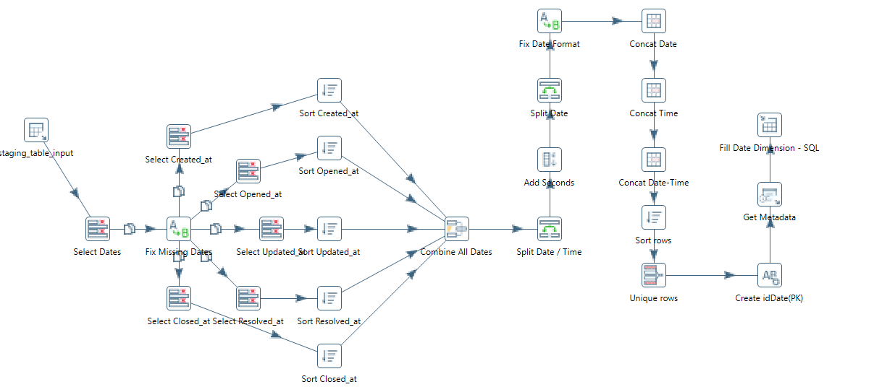
Loading Date Dimension
Adds : seconds HH:MM:SS
Formats all dates to : YYYY/MM/DD
Merged date and time.
Date as
2016-02-29 01:16:00.000
Notes:
ETL for Date Dimension:
1. Selected the all the columns containing a Date and renamed them to
"Opened_at" "Created_at" "Updated_at" "Resolved_at" "Closed_at“
2. Replaced the missing dates:
"Created_at" with the same date of "Opened_at".
"Resolved_at" with the same date of "Closed_at".
3. Stacked all the Dates.
4. Generated the correct format to store the Date/Time:
a. Added the seconds to format HH:mm:SS
b. Formated the YYYY/MM/DD.
c. Merged the Date/Time and kept the YYYY - MM - DD colums too.
5. Identified the unique Date/Time after making sure all of them were in the same format.
6. Created the IdDate(Primary Key) triming the Date/Time values and keeping only the digits.
7. Got the Metadata of running this transformation.
8. Loaded the rows to the Database – dim_date.

Slide 32
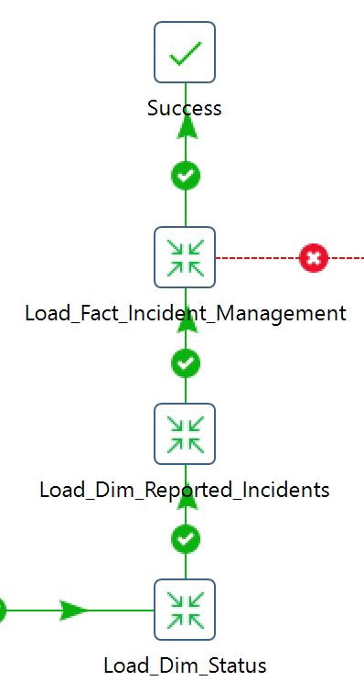
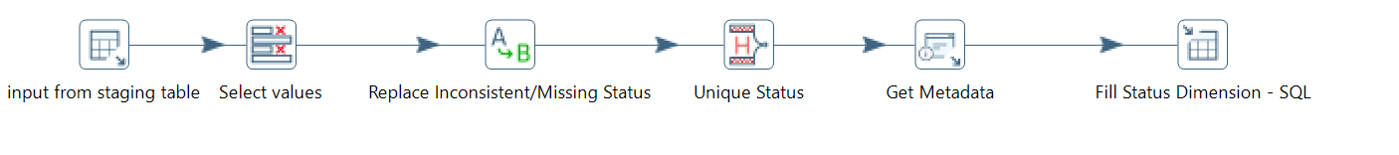
Loading Status Dimension
Notes:
ETL for Satus Dimension:
1. Selected the Status columns and rename them to = "Active" "Status_Description".
2. Replaced the missing and inconsistent values with a Generic Status = "Active".
3. Identified the possible unique combinations.
5. Got the Metadata of running this transformation.
6. Loaded the rows to the Database – Dim Status Table.

Slide 33
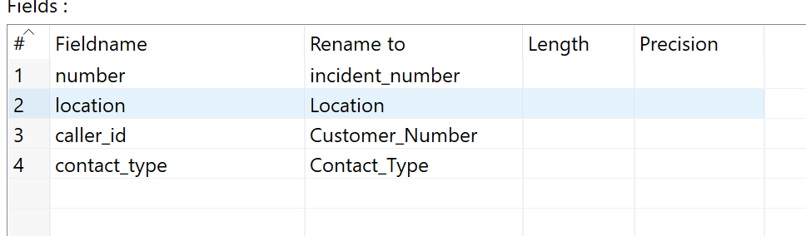
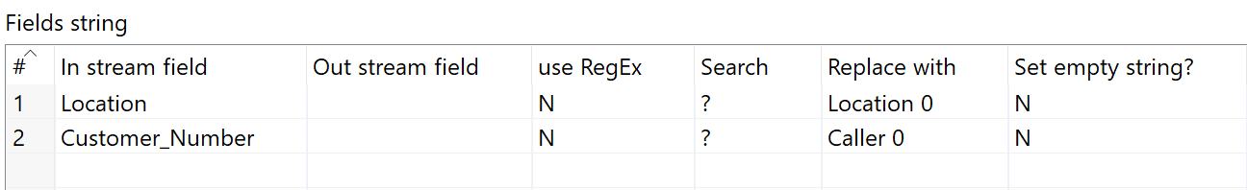
Loading Reported Incident Dimension
Notes:
This process cover the ETL for Incident Dimension:
1. Selected the Incident columns and rename them to = "idIncident" "Contact_Type" "Location" "Customer_Number".
2. Replaced the missing values with a Generic Location and Customer = "Location 0" - "Caller 0".
3. Identified the unique incidents.
4. Got the Metadata of running this transformation.
5. Loaded the rows to the Database - Incident Table.

Slide 34
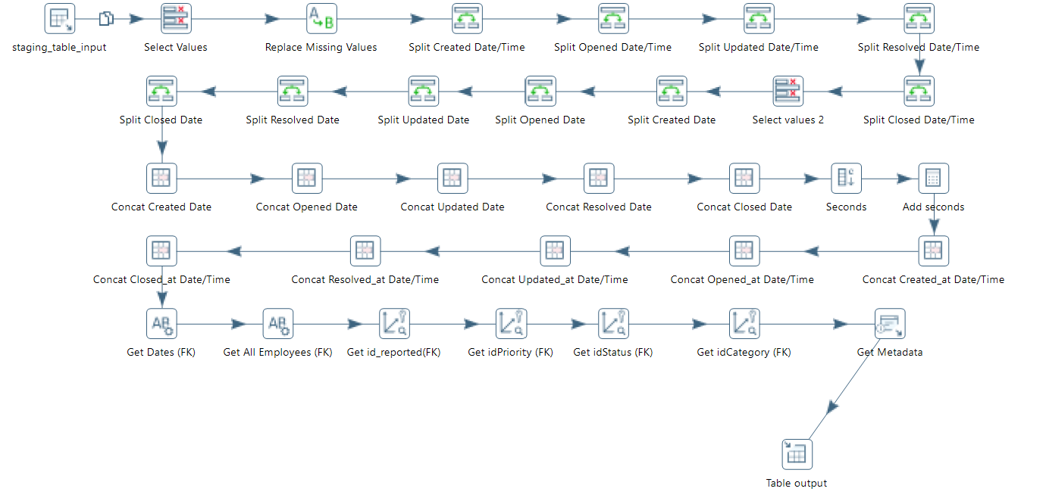
Loading Incident Fact Table
Notes:
This process cover the ETL for Incident Dimension:
1. Selected the Incident columns and rename them to = "idIncident" "Contact_Type" "Location" "Customer_Number".
2. Replaced the missing values with a Generic Location and Customer = "Location 0" - "Caller 0".
3. Identified the unique incidents.
4. Got the Metadata of running this transformation.
5. Loaded the rows to the Database - Incident Table.

Slide 35
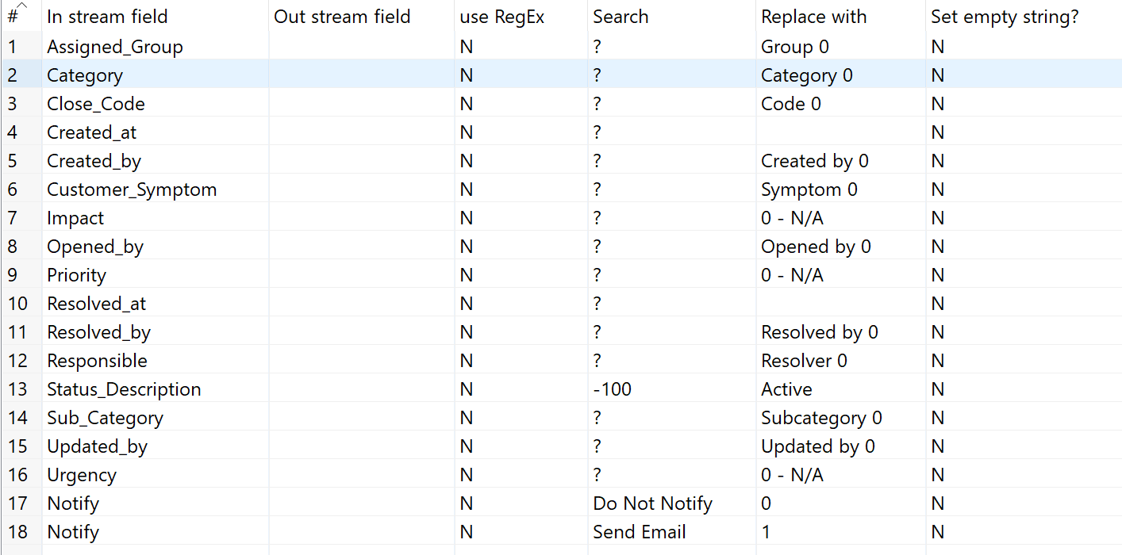
Notes:
This process cover the ETL for Incident Management - Fact Table:
1. Selected the all the columns containing the Facts: 26 Input Columns.
2. Validate Data Quality:
a. Replaced missing values aligned with the business rules applied for dimensions.
b. Replaced "Notify" by Boolean values (0,1).
c. Replaced missing "Assigned_Groups" with Generic "Group 0".
d. Replaced missing "Close_Code" with Generic "Code 0".
3. Fixed the Date/Time format for 5 columns following the same process of the Date Dimension.
a. Added the seconds to format HH:mm:SS
b. Formated the YYYY/MM/DD.
c. Merged the Date/Time.
4. Generated the Dates FK triming the Date/Time values and keeping only the digits.
5. Generated the FKs for Status, Priority and Category by associating the values to the primary key of each dimension.
6. Created a sequence as the IdIncident_Management(Primary Key).
7. Got the Metadata of running this transformation.
8. Loaded the rows to the Database - Incident Management Fact Table.

Slide 36
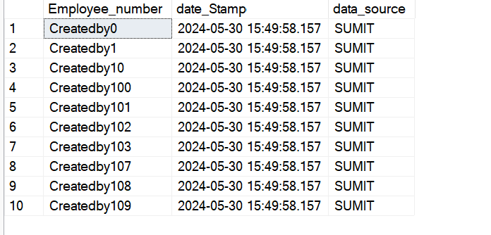
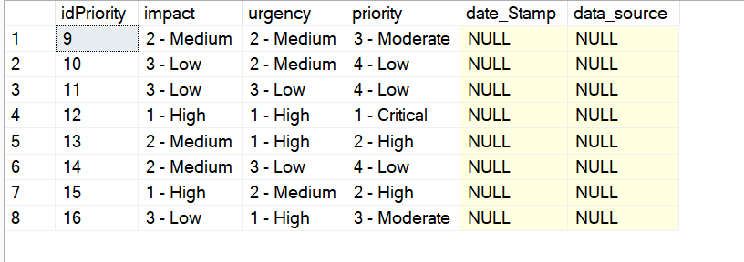
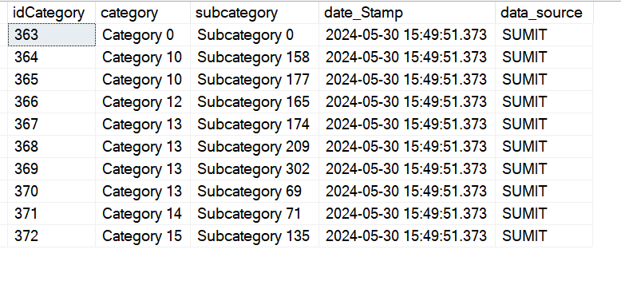
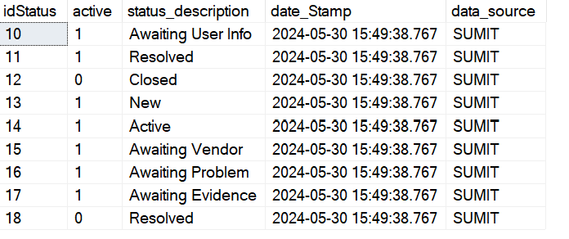
DIM after ETL Mapping
dim_employee
dim_priority
dim_status
dim_category

Slide 37
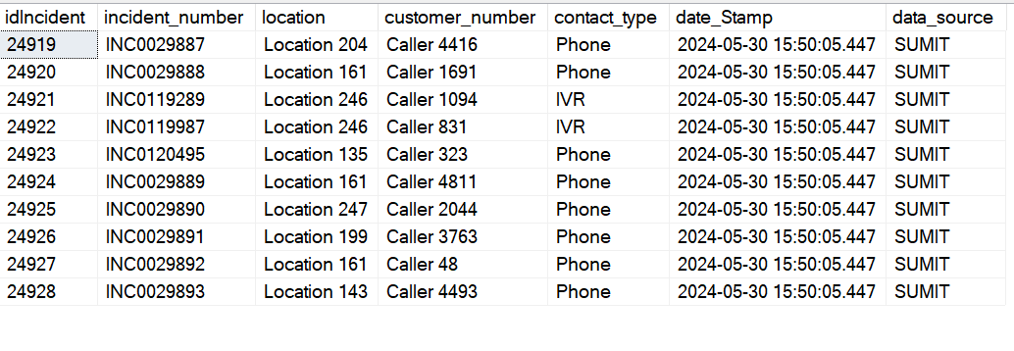
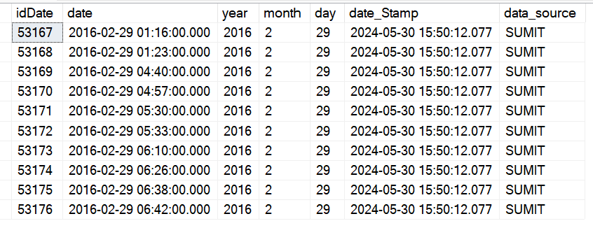
DIM after ETL Mapping
dim_reported
Schema has been set to ask for valid values and fields are not-null
dim_date
Before loading, a data validation lookup is done to check relationship between tables has been set to test PKs and FKs.

Slide 38
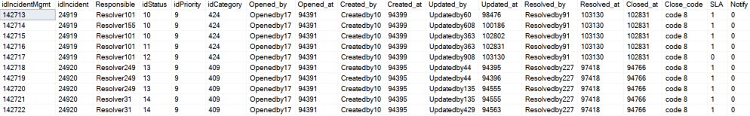
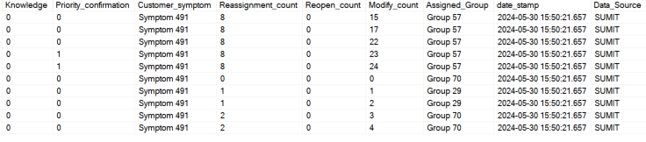
Fact Table after ETL Mapping

Slide 39
05
Getting Insights

Slide 40
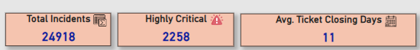
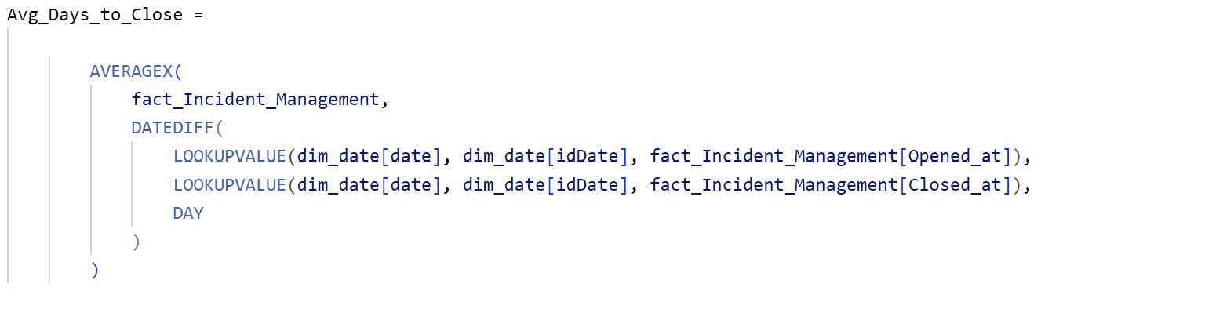
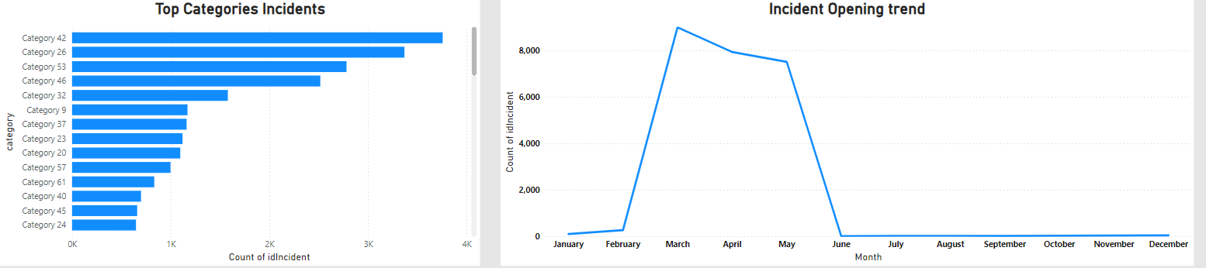
Getting Insights from Incident Dashboard
What are total number of incidents?
Number of Highly Critical Incidents?
What is Avg. ticket closing days?
Which category of incident is highly occurring?
What is the incident ticket opening trend ?

Slide 41
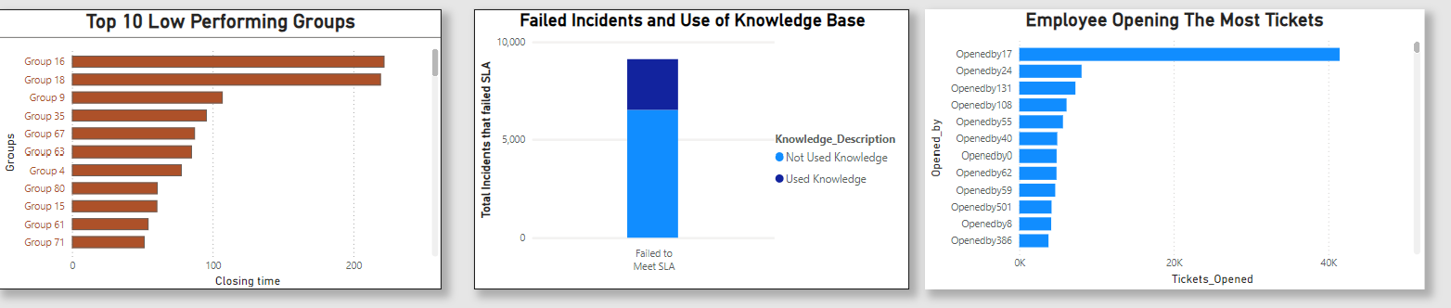
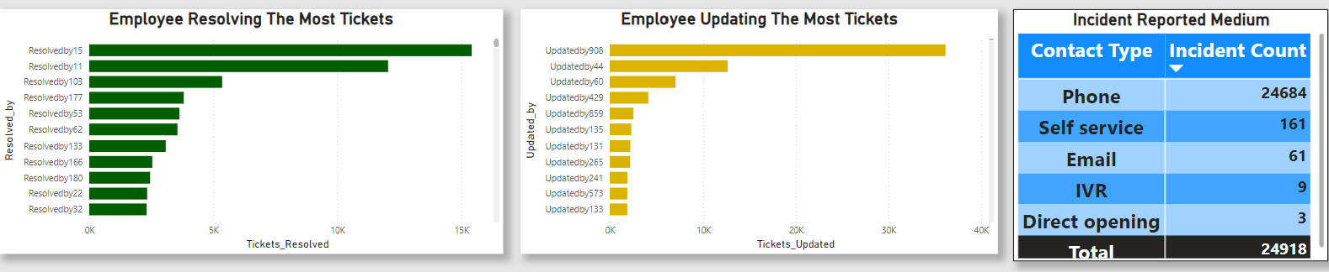
Getting Insights from Incident Dashboard
Which is low performing group?
Are they using the knowledge base?
Who is opening, updating, resolving the most ticket ?
Top mediums for reporting incidents?

Slide 42
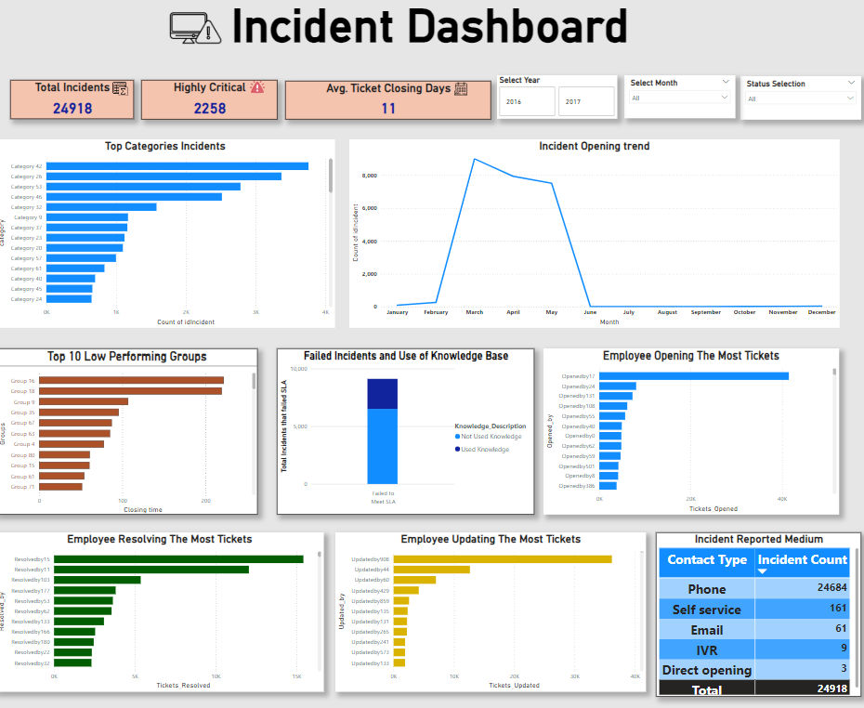
Final Dashboard (Power BI)

Slide 43
Techology Used
Data Preprocessing and EDA
Visualization
Vscode+Jupyter Notebook (python)
Pandas
Numpy
Matplotlib
sqlalchemy
Power BI
DBMS for Database Warehouse
ETL
MS-SQL Server
Star Schema
Pentaho (Spoon) tool

Slide 44

06
Future Enhancement and Conclusion

Slide 45
Future Enhancement
Job Log Dimension can be created based on data_source, date_stamp fields created after each load.
Further visualisation can be added for more insights.
From historic to future prediction.
Conclusion
“An end-to-end business IT incident management problem was resolved by building a complete data warehouse solution from data gathering to gaining business performance.”

Slide 46

Thank You!
Any Question ?
You can find me at
chhets01@myunitec.ac.nz

